Slide 1
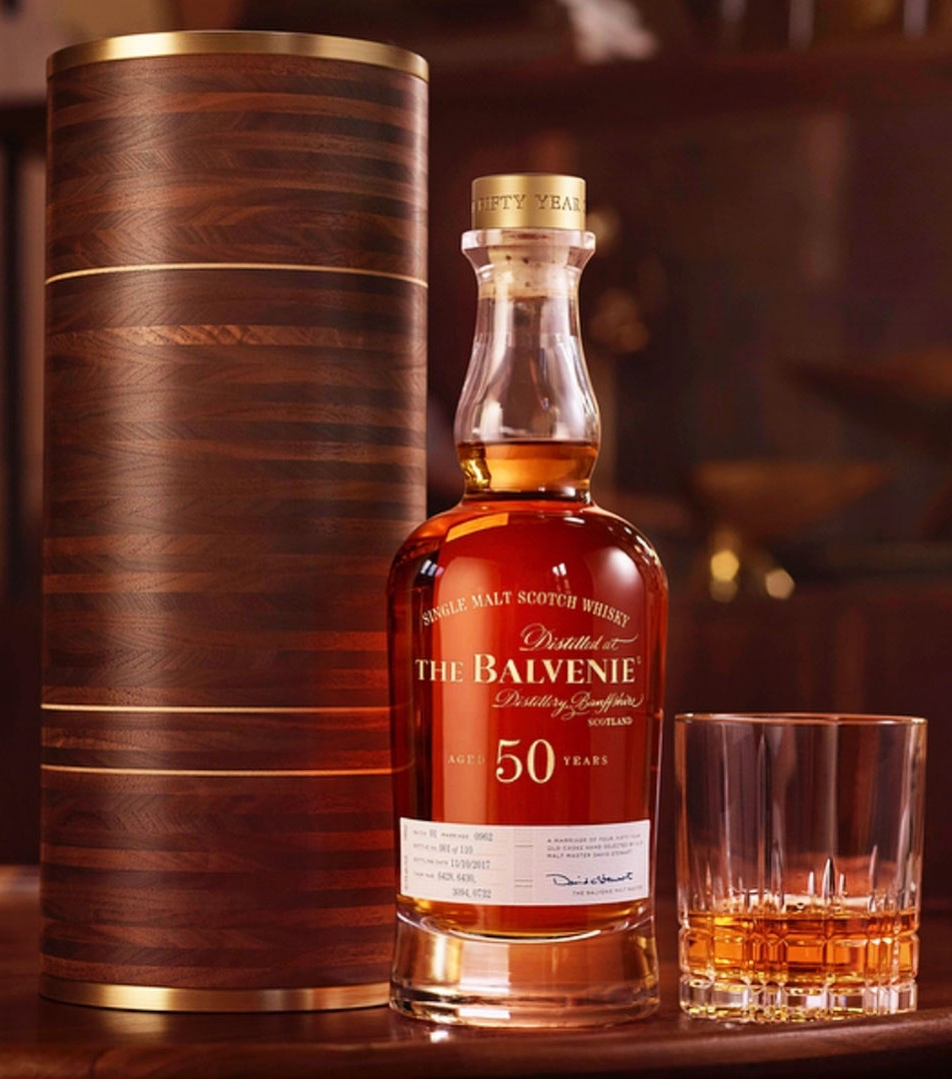
DRINKS and COCKTAILS RECOMMENDATION SYSTEM
Steven L Truong
Friday 05/27/2021

Slide 2
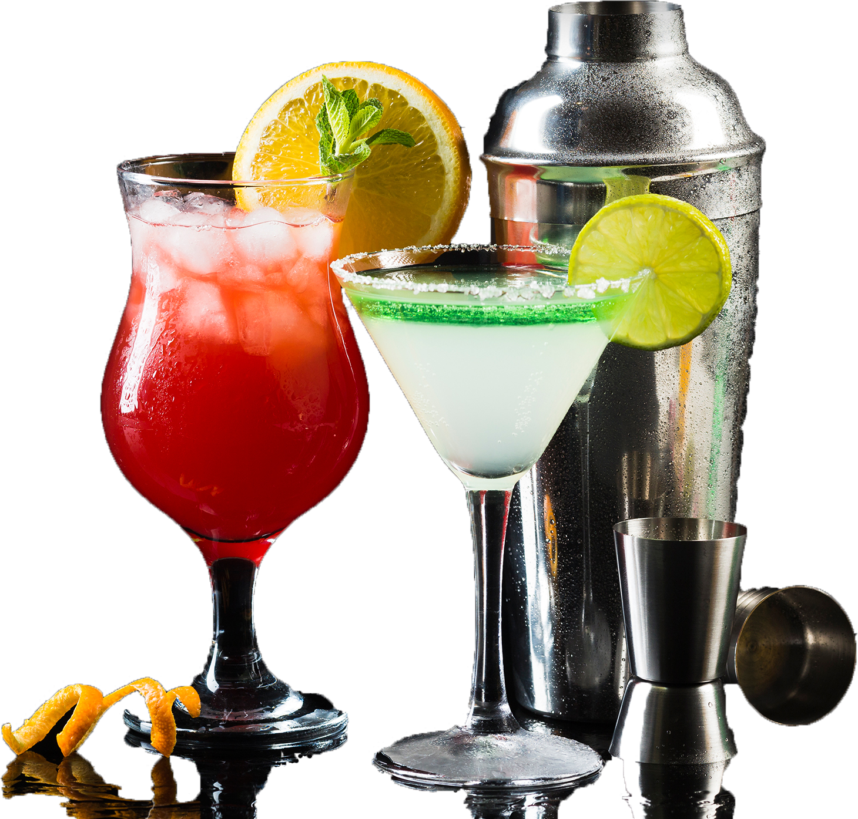
MOTIVATION

Slide 3


Slide 4
WORKFLOW

Slide 5
WORKFLOW
DATA
Scrape data and API calling

Slide 6
WORKFLOW
DATA
EDA
Scrape data and API calling
Visualize the data and sentiment analysis

Slide 7
WORKFLOW
DATA
EDA
TOPIC MODELING
Scrape data and API calling
Visualize the data and sentiment analysis
TF-IDF Vectorizer and NMF(15)

Slide 8
WORKFLOW
DATA
EDA
TOPIC MODELING
REC-SYS
Scrape data and API calling
Visualize the data and sentiment analysis
TF-IDF Vectorizer and NMF(15)
Take user’s input and recommend the most relevant products

Slide 9
WORKFLOW
DATA
EDA
TOPIC MODELING
REC-SYS
DEPLOYMENT
Scrape data and API calling
Visualize the data and sentiment analysis
TF-IDF Vectorizer and NMF(15)
Take user’s input and recommend the most relevant products
Build streamlit app and deploy to share.streamlit

Slide 10

DATA GATHERING
Scraped from multiple sources and API calling

Slide 11
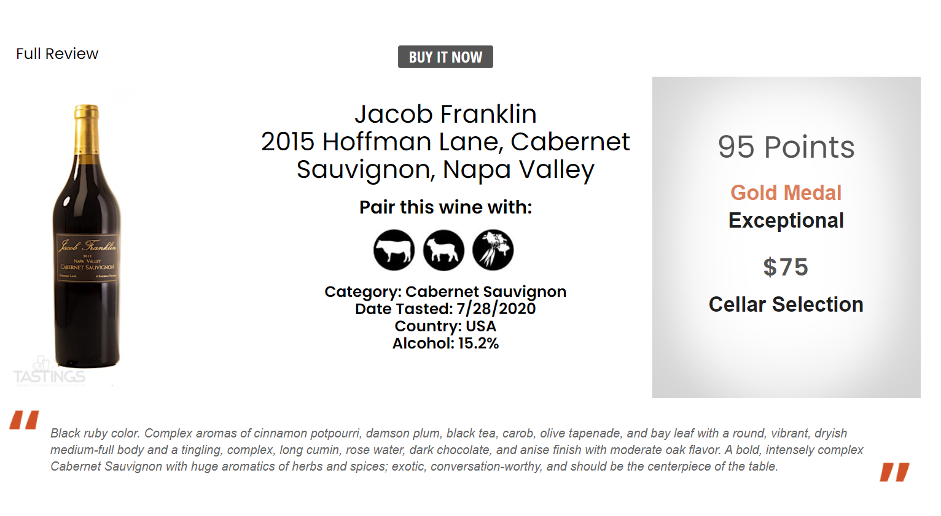

Slide 13
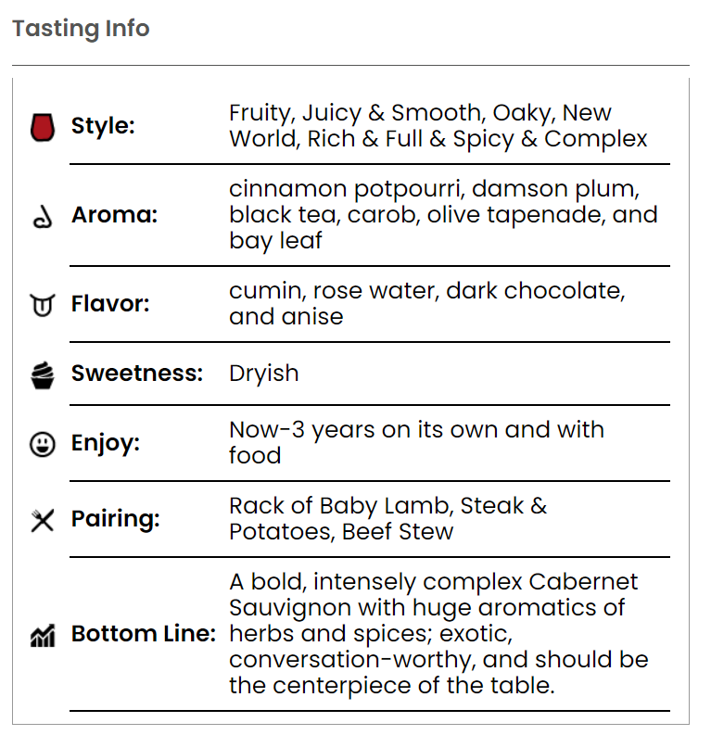
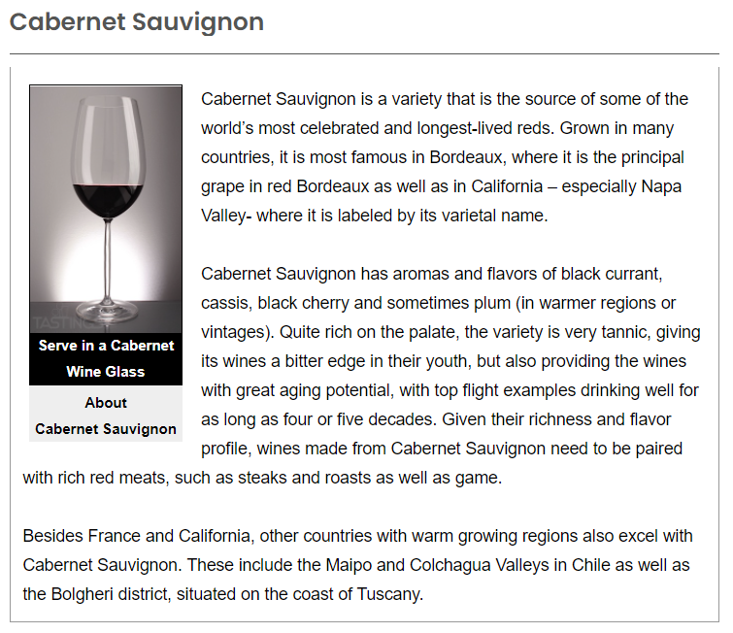

Slide 14

Exploratory data analysis
EDA and sentiment analysis

Slide 15
EDA and Sentiment Analysis

Slide 16
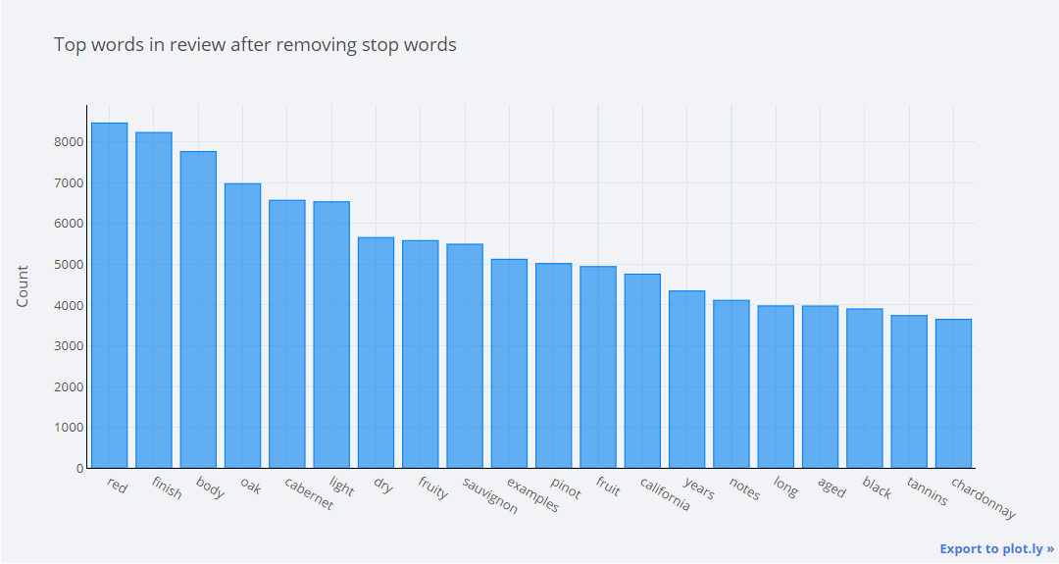
EDA and Sentiment Analysis

Slide 17
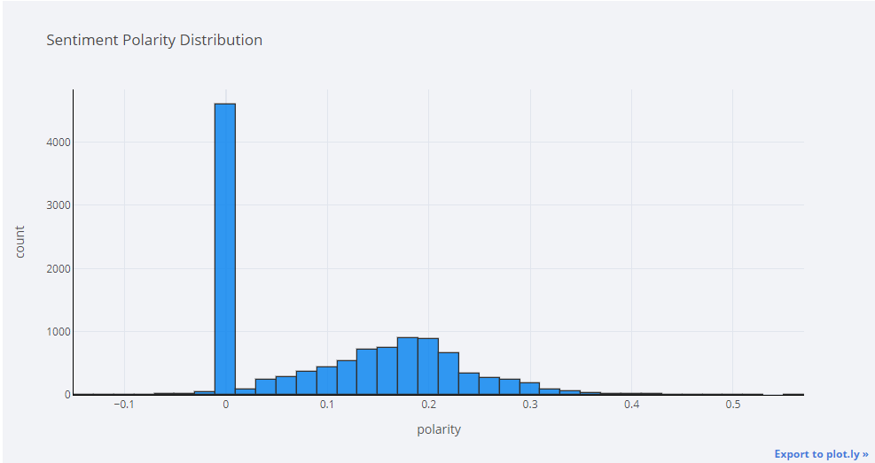
EDA and Sentiment Analysis

Slide 18
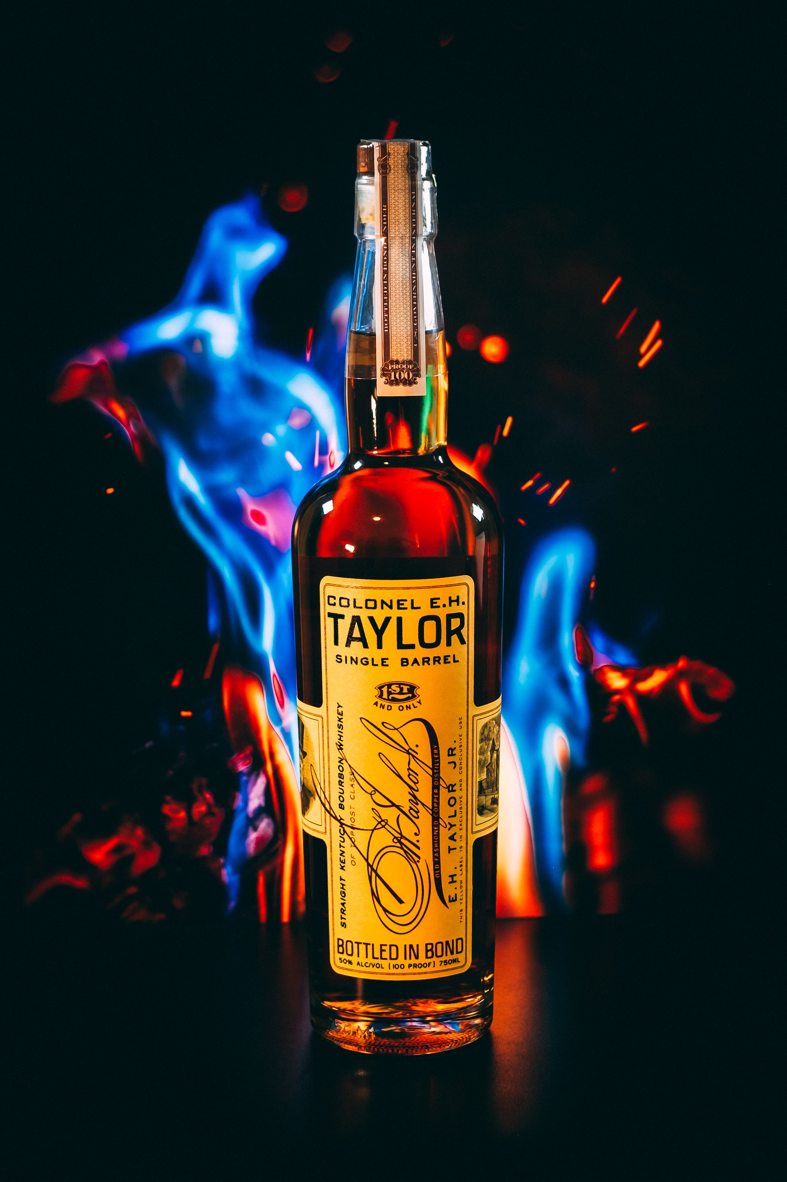
Topic Modeling
TF-IDF Vectorizer and NMF(15 components)

Slide 19
Coherence Scores

Slide 20
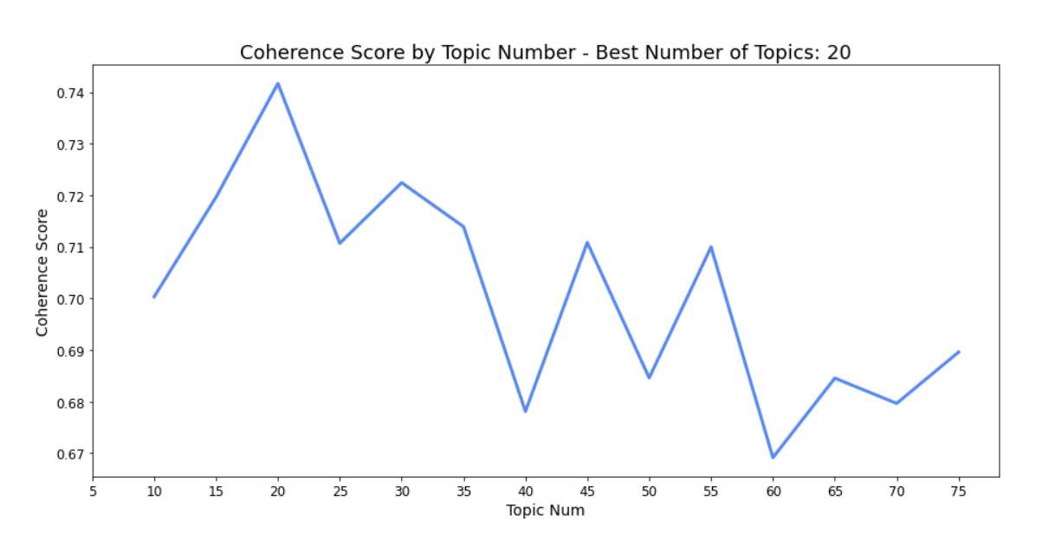
Coherence Scores

Slide 21

15 topics

Slide 22
15 topics
Based on type and flavor of alcohols
Let’s take a look at few topics

Slide 23

List of topics
Cheap, affordable, good value
Bittering hop IPA
White and spiced Rum
Oaky, fruity Red blend and Merlot
Dried sour cherries flavored Pinot Noir
Sweet and fruity cider
Dry and oaky Chardonnay
Non-smoky, sweet Rose
Fruity Sauvignon Blanc
Straight and flavored Vodka
Whiskey (Bourbon and Scotch)
Sweet, light, and corn beer
Smooth and dry tequila
Cocktail mixers (ready-to-drink cocktails)
Dry Gin

Slide 24
Cheap, affordable, good value

Slide 25
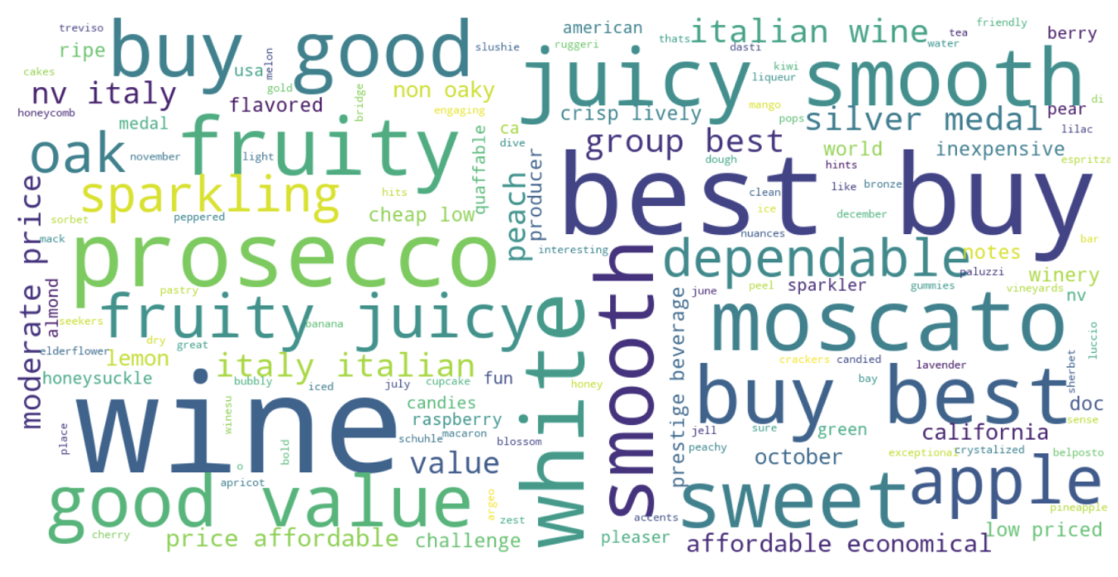
Cheap, affordable, good value

Slide 26
Whiskey, bourbon with rich flavor

Slide 27
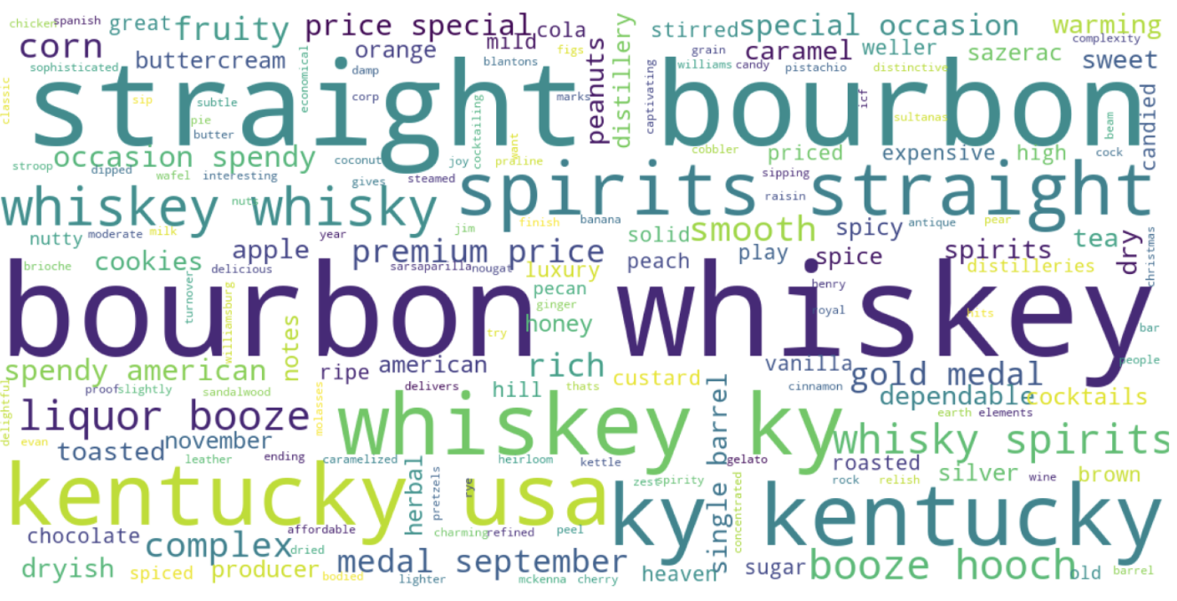
Whiskey, bourbon with rich flavor

Slide 28
All 15 topics

Slide 29
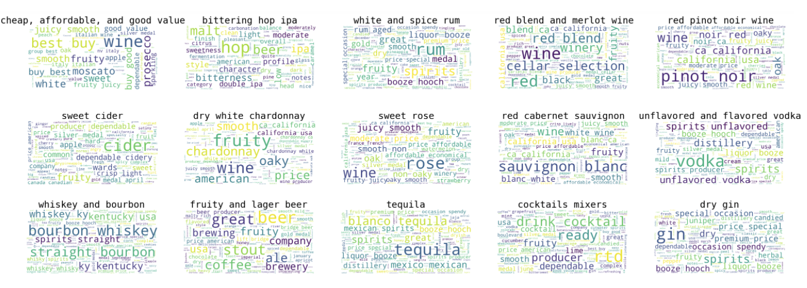
All 15 topics

Slide 30
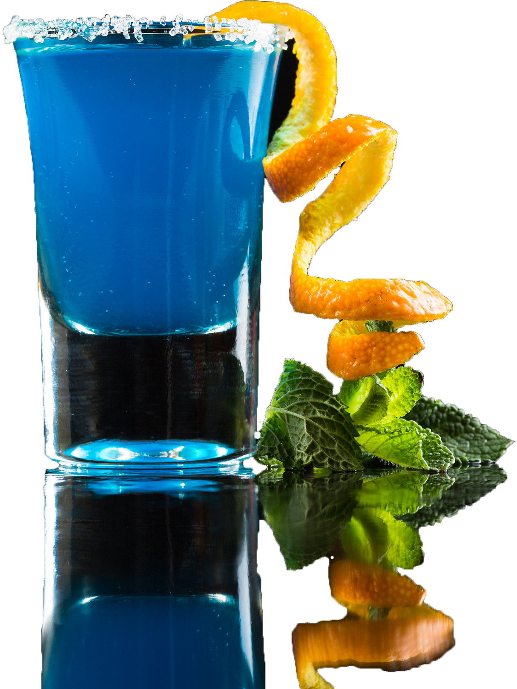
Recommendation System Application Deployment
Build and deploy to streamlit

Slide 31

DEMONSTRATION
How do we know that our system work? Let’s see it in action!

Slide 32
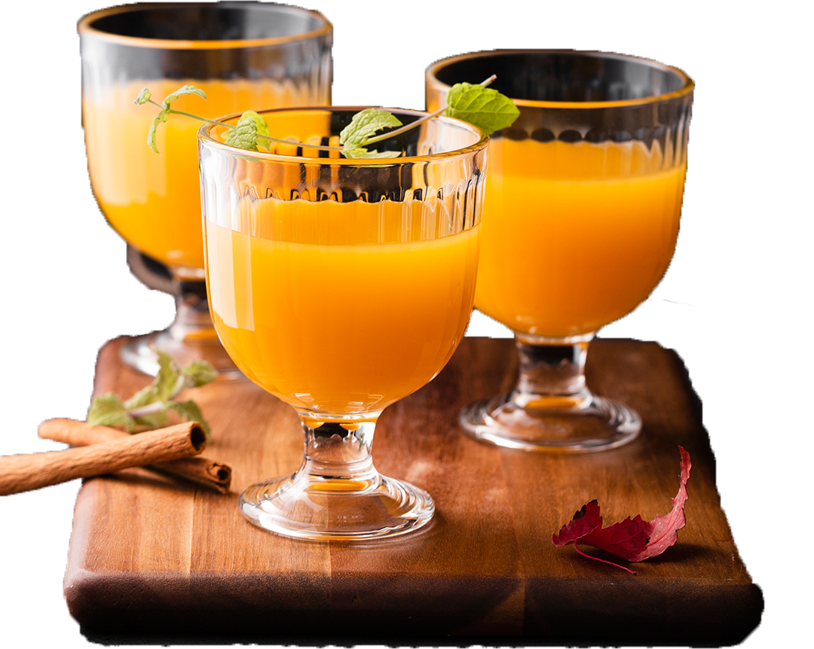
FUTURE WORK
ALGORITHMS
Try other clustering algorithms (K-means, DBSCAN)
Optimize the recommendation system
DATA
Gather more data to recommend users.

Slide 33

THANK YOU
Steven L Truong
Please reach out to me at https://www.linkedin.com/in/luongtruong77/

Slide 34
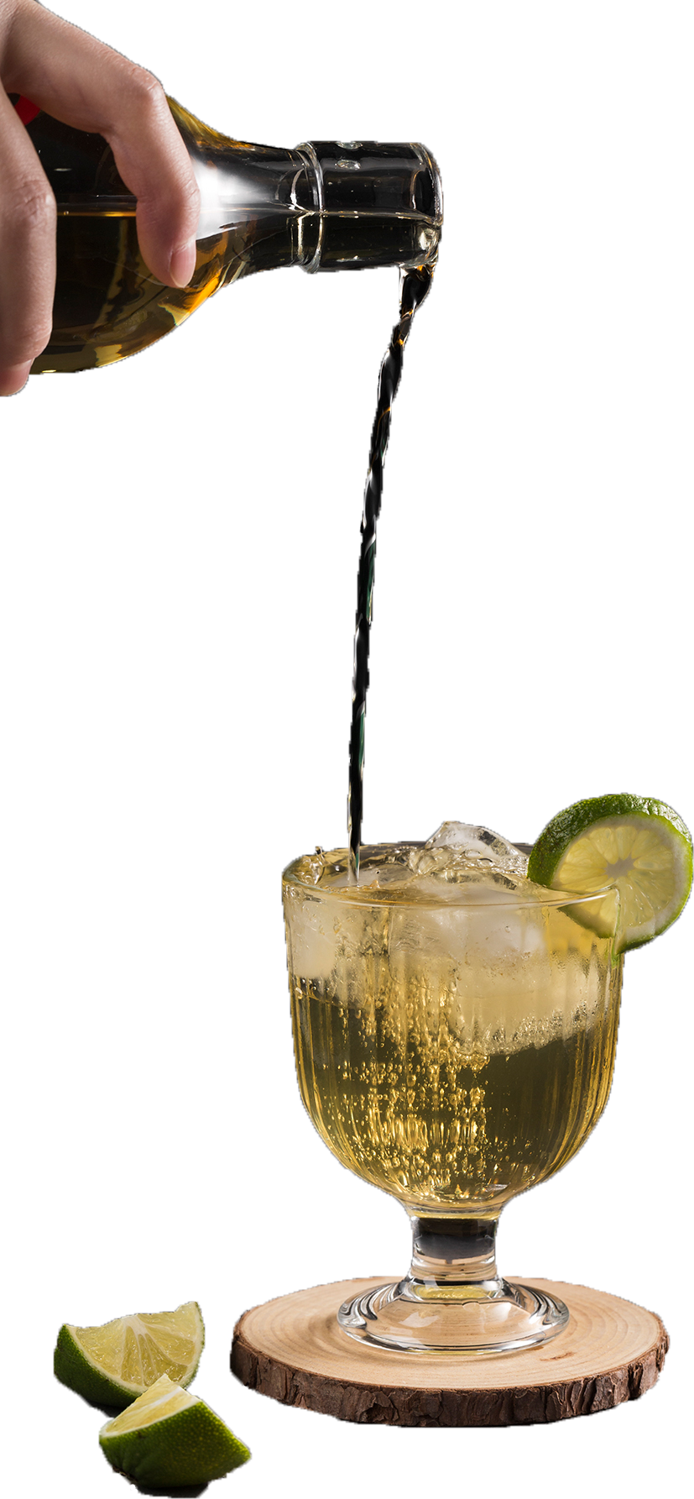
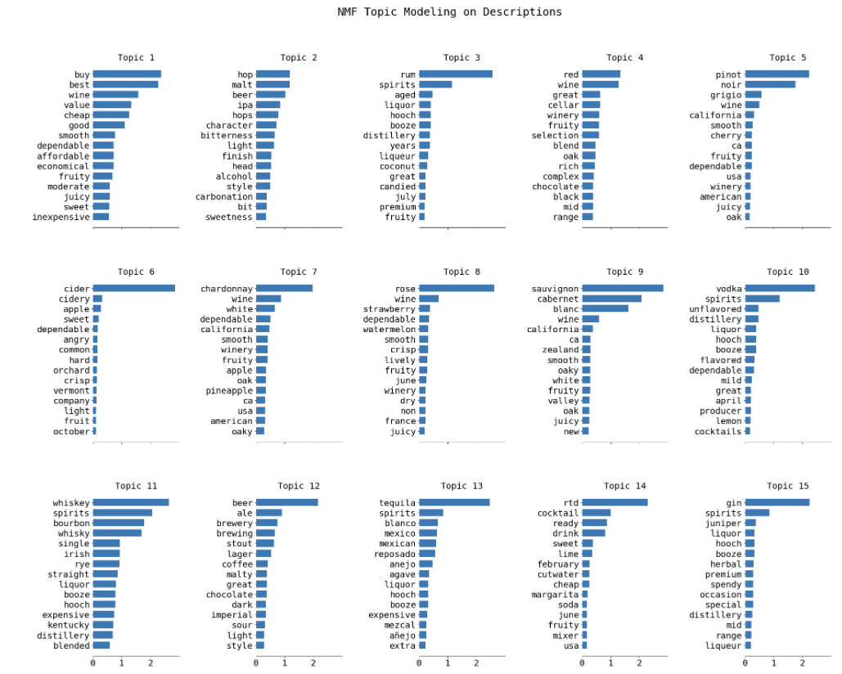
Appendix

Slide 35
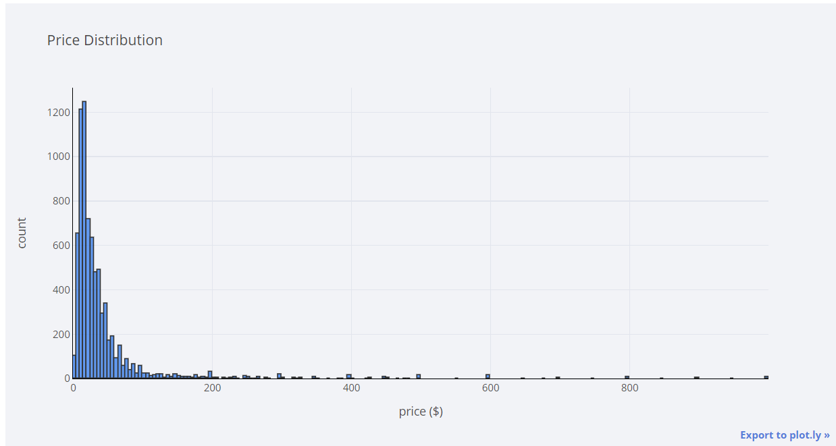
Appendix

Slide 36
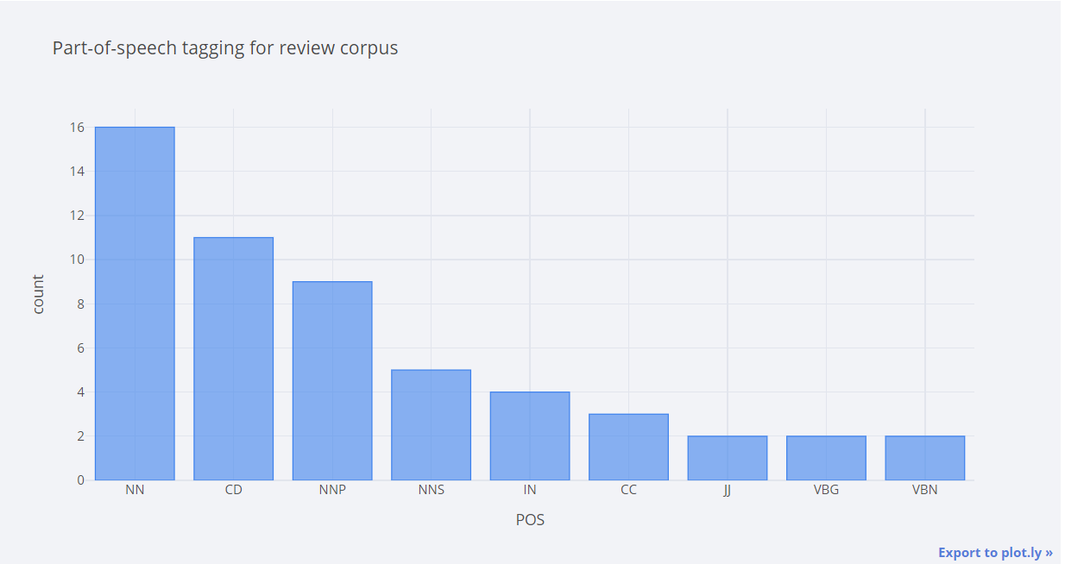
Appendix

Slide 37
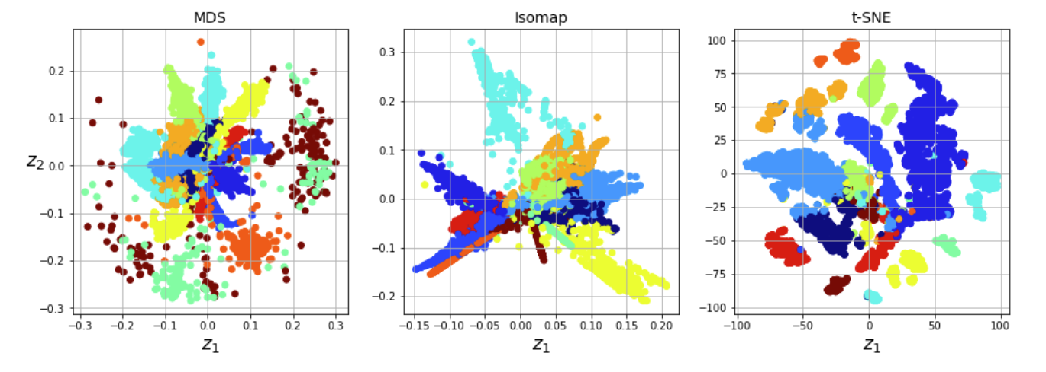
Appendix

Slide 38
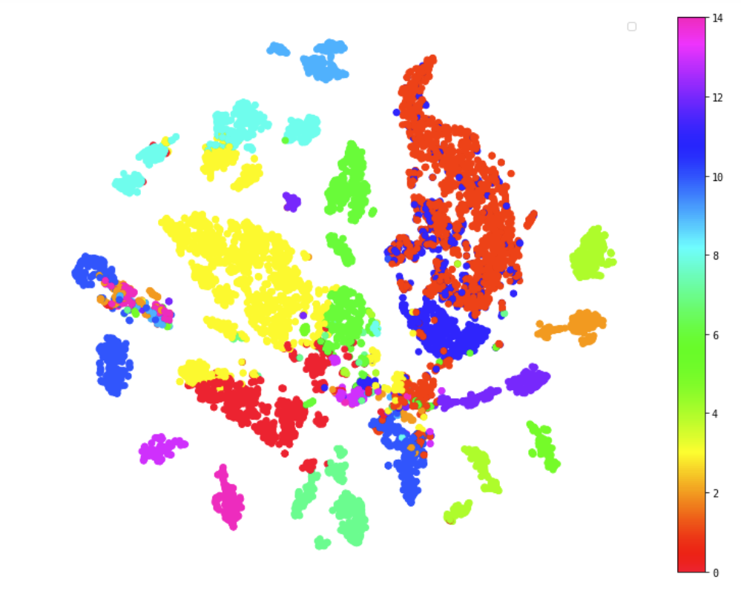
Appendix

